Slide 1



SMART INDIA HACKATHON 2025
TITLE PAGE
Problem Statement ID – 25093
Problem Statement Title- Centralised Digital Platform for Comprehensive student activity record in HEIs
Theme- Smart Education
PS Category- Software
Team ID-
Team Name- Immortals

Slide 2

IDEA TITLE
Immortals
How It Addresses the Problem:
Ends Data Fragmentation: It creates a single, secure, digital source of truth, eliminating scattered files and lost paper records, which drastically improves institutional efficiency.
Streamlines Accreditation: It automates the collection and consolidation of student achievement data, significantly reducing the administrative burden and manual effort required for accreditation reports (NAAC, NBA, etc.).
Empowers Students for Placements: It provides students with a university-verified, dynamic portfolio, enabling them to effectively showcase their holistic skills and experiences to recruiters and admissions committees.
Enhances Transparency and Mentorship: Offers real-time visibility into a student's complete profile, empowering faculty with the data needed for more effective, evidence-based mentoring
Problem Statement:
Despite increasing digitization in education, student achievements ranging from academic excellence to participation in curricular and extracurricular activities remain scattered across various departments or lost in paper-based records, in many colleges and universities.
Proposed Solution:
A Centralized Digital Ecosystem: We propose the "Smart Student Hub," a centralized web and mobile platform designed to be the single source of truth for all student activities.
Seamless Capture & Verification Workflow: The platform enables students to easily upload their achievements, which are then queued for faculty to review and verify, ensuring the credibility of every record.
Dynamic Digital Portfolio Generation: It automatically consolidates all verified achievements into a comprehensive, shareable, and lifelong digital portfolio, available as both a live web link and a downloadable PDF.
Innovation and Uniqueness:
Institution-Verified Credibility: Unlike self-reported platforms, every achievement is verified by faculty. This creates an unparalleled level of trust and authenticity for recruiters and admissions committees.
Purpose-Built for Accreditation: The platform features an analytics engine specifically tailored for compliance reports (NAAC, NIRF), directly automating a complex and manually intensive process for universities.
Beyond Transcripts - A Holistic View: It moves beyond the limitations of a traditional transcript (CGPA) to capture and showcase the complete student journey, including practical skills, leadership roles, and community impact.
2

Slide 3
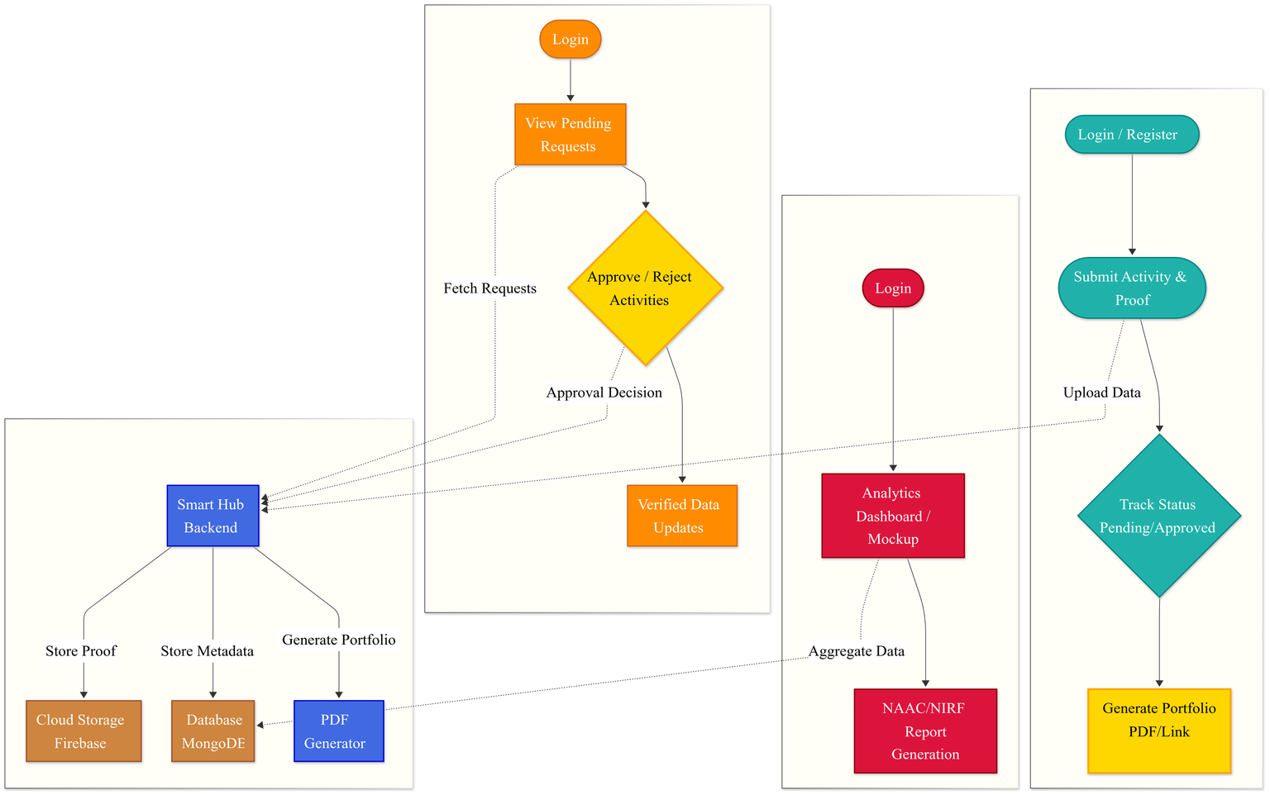





TECHNICAL APPROACH
Immortals
Workflow:
Faculty Journey
Steps:
User Authentication & Onboarding 🔑: Secure, role-based login for students, faculty, and admins to access their dedicated dashboards.
Activity Submission & Upload ⬆️: Students use a simple form to submit activity details and upload proof (like PDFs or images) to the backend.
Secure & Scalable Data Storage 💾: For efficiency, activity metadata is stored in MongoDB for fast access, while proof files are securely kept in Firebase Cloud Storage.
Faculty Verification Workflow ✅: Submissions enter a queue for faculty to review and then approve or reject them via their dashboard.
Dynamic Portfolio Generation 📄: On-demand, the system generates a shareable digital portfolio from verified records, available as a web link or a downloadable PDF.
Accreditation Analytics & Reporting 📊: An admin dashboard aggregates verified data to automatically generate custom reports and analytics for accreditation bodies like NAAC and NIRF.
Student Journey
Institutional/ Admin Journey
Technology Stack:
Programming languages | Frameworks and libraries | Database /storage
Javascript (node.js) | React.js/Next.js, tailwindcss Material UI | Mongo db, firebase
3

Slide 4
FEASIBILITY AND VIABILITY
Immortals
Feasibility Analysis:
Technical Feasibility: The solution is built on a mature and widely-adopted tech stack (React, Node.js, Firebase), ensuring rapid development and a stable, scalable product. It leverages standard cloud infrastructure, requiring no specialized hardware for implementation by universities.
Operational Feasibility: The platform is designed to automate and simplify existing manual workflows, reducing the operational burden on faculty and staff. An intuitive, user-centric design ensures that both students and faculty can adopt the system with minimal training.
Potential Challenges and Risks:
User Adoption & Change Management:
Faculty Hesitation: Faculty may perceive the platform as an additional administrative burden rather than a time-saving tool, leading to slow or inconsistent adoption.
Student Engagement: Ensuring students consistently and accurately upload their activities throughout their academic journey, not just during their final year for placements.
Technical & Security:
Data Security & Privacy: Handling a large volume of sensitive student data (PII) requires strict adherence to data protection laws and robust safeguards against potential security breaches.
Integration Complexity: Many universities utilize older, legacy ERP systems with limited or poorly documented APIs, which can make seamless data integration a significant technical hurdle.
Strategies for Overcoming Challenges:
Driving User Adoption:
A mobile-first, intuitive UI/UX focused on ease of use.
Clear communication of the value proposition: significant time saved for faculty and tangible career benefits for students.
Ensuring Robustness & Integration:
Implementing a comprehensive security framework from day one, including role-based access control and data encryption.
Building a flexible, API-first architecture that allows the platform to function standalone or integrate with other systems via well-documented APIs.
4

Slide 5
IMPACT AND BENEFITS
Immortals
Impact on Target Audience:
For Students:
Immediate Impact:
Enhanced Employability: Provides a verified, comprehensive portfolio that boosts credibility and helps them stand out in competitive job markets.
Stronger Higher-Ed Applications: Enables them to showcase a holistic profile beyond grades, strengthening applications for postgraduate programs and scholarships.
Future Impact:
AI-Powered Career Guidance: Evolves into a lifelong career companion that actively helps build optimized resumes, and matches them with the right opportunities.
Lifelong Learner Record: Becomes a permanent, portable record of their skills and achievements that they can build upon throughout their professional careers.
For Institutions (HEIs):
Immediate Impact:
Reduced Administrative Overhead: Drastically reduces the manual effort and time required for accreditation data collection and reporting.
Improved Data Accuracy: Centralizes data, eliminating errors and inconsistencies common with manual, decentralized record-keeping.
Future Impact:
Data-Driven Strategic Insights: Provides valuable analytics on student engagement and its correlation with placement success, enabling data-informed decision-making.
Enhanced Institutional Reputation: Helps improve placement outcomes and can boost global rankings by showcasing the comprehensive development of its students.
Broader Benefits of the Solution:
Economic Benefits
Reduces operational costs for universities by automating administrative tasks.
Creates a more skilled workforce by making student skills visible and verifiable, directly addressing industry needs.
Social Benefits
Promotes a culture of holistic development by encouraging students to participate in diverse activities, making these efforts visible and valued.
Helps close the skills gap by creating a trusted ecosystem that better connects verified student talent with industry opportunities.
5

Slide 6


RESEARCH AND REFERENCES
Immortals
National Education Policy (NEP) 2020: Research on the NEP's emphasis on holistic, multidisciplinary education.
Link: https://www.education.gov.in/en/nep/multidisciplinary-holistic-education
NAAC Accreditation Manual: Analysis of NAAC manuals, focusing on Criterion 5 (Student Support and Progression).
Link: https://www.rkgit.edu.in/IQAC/NAAC-SSR/Criterion5/
NBA Graduate Attributes: Study of the National Board of Accreditation's required Program Outcomes (POs) and Graduate Attributes.
Link: https://submissions.ijskit.org/index.php/ijskit/article/download/213/204/
Open Badges Standard: Review of the global trend towards micro-credentials and the Open Badges standard for verifiable skills.
Link: https://www.pok.tech/en/open-badge-3-0
6

